Slide 1
Chapter-5 Interacting with Database
Marks=12
Prepared by: Prof. Biradar R.Y.

Slide 2
Introduction to JDBC
JDBC - Java Database Connectivity
JDBC is a Java API to connect and execute the query with the database
Used to access tabular data stored in any relational database
Package: java.sql
JDBC drivers enable you to open database connections and to interact with it by sending SQL or database commands then receiving results with Java.

Slide 3
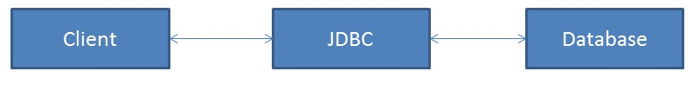
Introduction to JDBC (Cont..)
A driver works as an interface between the client and a database server.
Allow a java application to send request made by user to any specific DBMS.
JDBC supports a wide level of portability.
JDBC provides interfaces that are compatible with java application

Slide 4
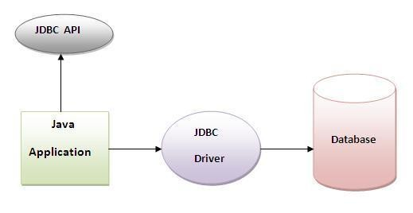
JDBC API
JDBC is a Java API that is used to connect and execute query for the database.
JDBC API uses jdbc drivers to connects to the database.
Using JDBC API, we can save, update, delete and fetch data from the database

Slide 5
Classes in JDBC API
DriverManager class
Blob class
Clob class
Types class

Slide 6
Interfaces in JDBC API
Driver interface
Connection interface
Statement interface
PreparedStatement interface
CallableStatement interface
ResultSet interface
ResultSetMetaData interface
DatabaseMetaData interface

Slide 7
Why JDBC?
JDBC drivers written in Java language.
So platform independent and secured
JDBC is object oriented.

Slide 8
ODBC
Open Data Base Connectivity
Developed by Microsoft for the Windows platform as the way for Windows applications to access Microsoft databases (SQL Server, FoxPro, Access)
developed in C programming.
It is low level, high performance interface that is designed specially for relational data stores.

Slide 9
ODBC
We can use ODBC for any language like C,C++,Java etc.
ODBC is procedural
ODBC permits maximum interoperability, which means a single application can access different DBMS.
ODBC handles the SQL request and converts it into a request the individual database system understands

Slide 10
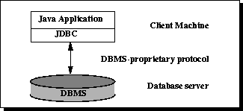
JDBC Architecture
The JDBC API supports both two-tier & three-tier architecture
Two-tier Architecture for Data Access:
client/server configuration
divided into two parts: 1) Client Application (Client Tier)
2) Database (Data Tier)

Slide 11
Two-tier Architecture for Data Access:
Advantages: 1. Easy to maintain
2. Communication is faster.
Disadvantages: 1. performance will be degrade upon increasing the users.

Slide 12
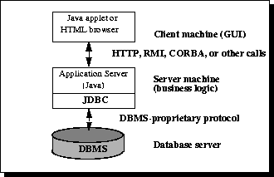
Three-tier Architecture for Data Access:
divided into three parts: 1)Client layer
2)Business layer
3)Data layer

Slide 13
Three-tier Architecture for Data Access:
Advantages: 1. Scalability 2. Performance 3. Better Re-usability. 4. Improve Data Integrity. 5. Improved Security – Client can’t directly access the database. 6. Easy to maintain, to manage, to scale, loosely coupled etc.
Disadvantages: 1. Increased Complexity

Slide 14
Java Application
JDBC API
Data Base Drivers
Access
SQL
Server
DB2
Informix
MySQ L
Sybase

Slide 15
JDBC Drivers and its types
JDBC driver implementation vary because of wide variety of OS, hardware, databases in which Java operates
four categories of drivers by which developer can apply a connection between Client to a DBMS.
Type 1 Driver : JDBC-ODBC Bridge.
Type 2 Driver : Native-API Driver (Partly Java driver).
Type 3 Driver : Network-Protocol Driver (Pure Java driver for database Middleware).
Type 4 Driver : Pure Java Driver, 100% Java

Slide 16
Type 1 Driver : JDBC-ODBC Bridge
Also known as a JDBC-ODBC Bridge.
The JDBC-ODBC bridge driver uses ODBC driver
to connect to the database.
It converts JDBC methods into ODBC function calls.
also called Universal driver because it can be used to connect to any of the databases.
Sun provides a JDBC-ODBC Bridge driver by “sun.jdbc.odbc.JdbcOdbcDriver”.
The driver is a platform dependent. It is not a portable driver.
The ODBC Driver needs to be installed on the client machine.

Slide 17
Type 1 Driver : JDBC-ODBC Bridge
used only when there is no PURE-JAVA driver available for a particular database.
Connect to almost any database on any system, for which ODBC driver is installed.
Data transferred through this driver is not so secure

Slide 18
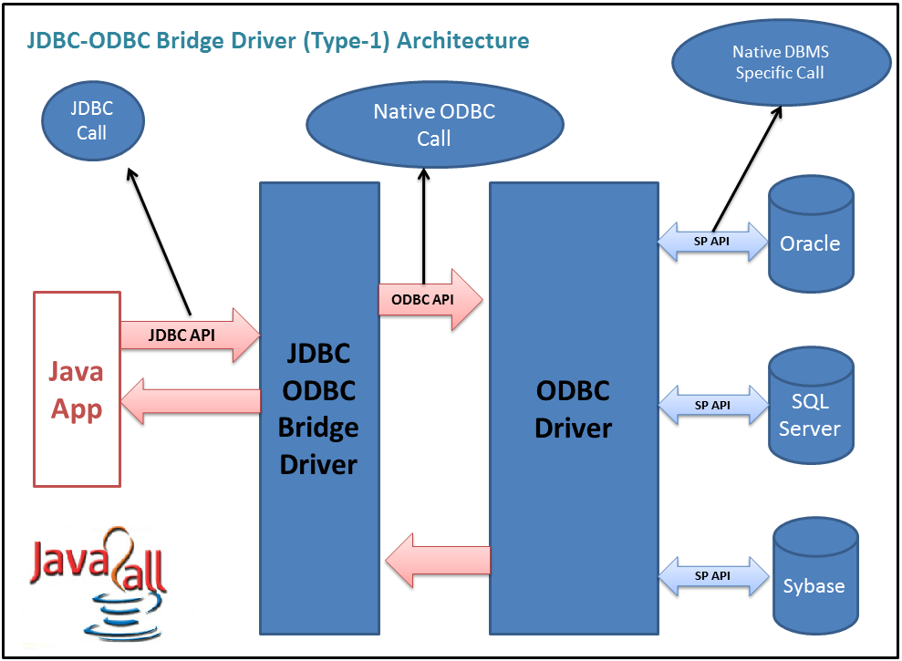

Slide 19
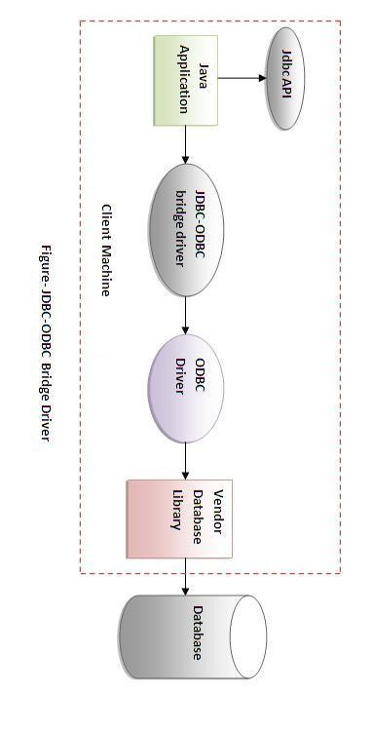

Slide 20
Type 2 Driver: Native-API Driver (Partly Java driver) :
It uses the client side libraries of the database
This driver converts the JDBC method calls into native(C/C++ API) calls of the database
Also known as a Native-API driver.
Data transferred through this driver is more secure
It’s faster than a type 1 driver
cannot be used in the web-based application.
This driver supports all JAVA applications except applets.

Slide 21
Type 2 Driver: Native-API Driver (Partly Java driver) :
The driver is a platform dependent. It is not a portable driver
Driver needs to be installed separately in individual client machines
client library needs to be installed on client machine.

Slide 22
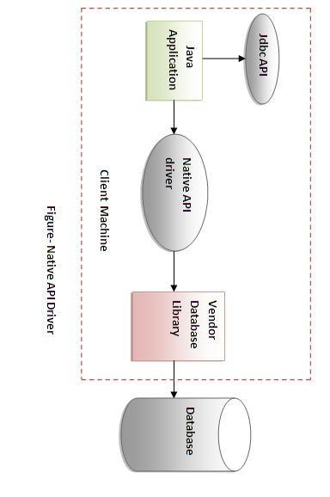

Slide 23
Type 3 Driver: Network-Protocol Driver (Pure Java driver for database Middleware) :
uses the middle tier.
middle tier converts JDBC method calls into the vendor specific database protocol
The same driver can be used for multiple databases. Driver is database independent
It’s also known as a Network-Protocol driver as well as a JAVA driver for database middleware.
used in any web application as well as on internet
It is fully written in java. Hence portable & platform independent

Slide 24
Type 3 Driver: Network-Protocol Driver (Pure Java driver for database Middleware) :
No client side library is required
No need of individual client-side installation.

Slide 25
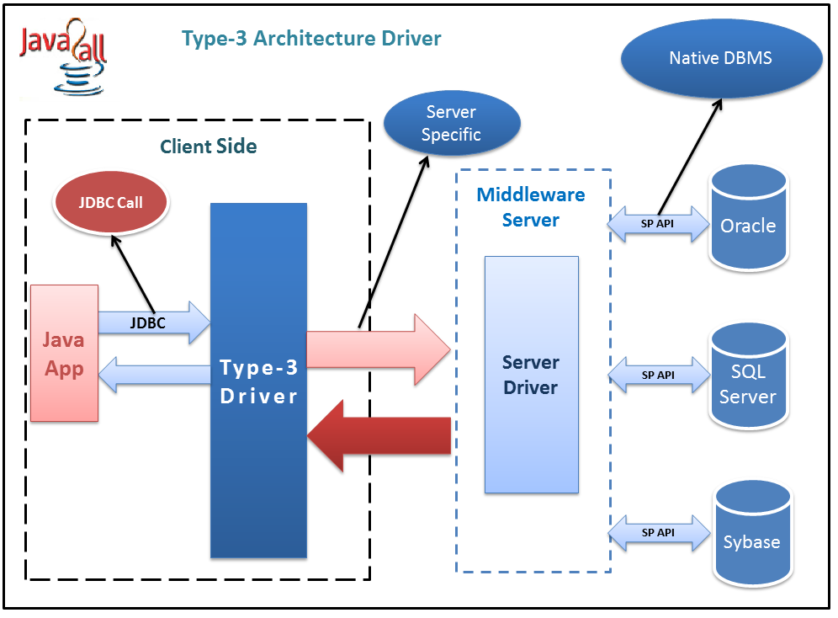

Slide 26
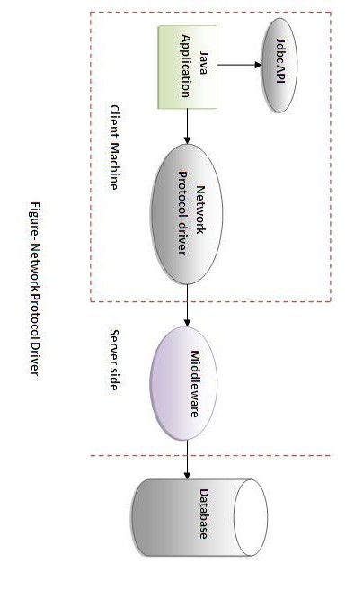

Slide 27
Type 4 Driver: Thin Driver (Pure Java driver directly connected to database)
It converts JDBC method calls directly into the vendor specific database protocol
Also known as native protocol driver
this is the fastest way to communicate queries to DBMS
Driver is database dependent .
Also known as the “direct to database Pure JAVA driver”.
It’s a 100% pure JAVA Driver so it’s a platform independent.
There is a separate driver needed for each database at the client side.

Slide 28
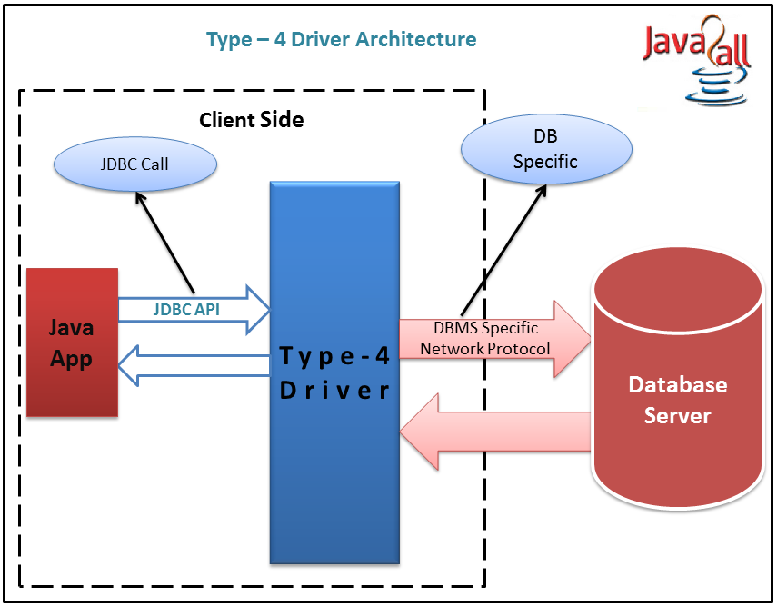

Slide 29
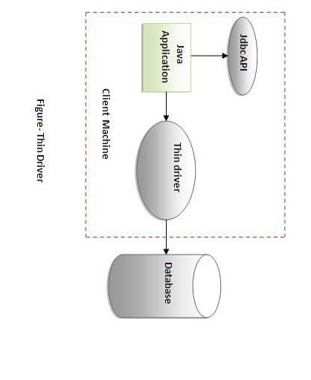

Slide 30
Which Driver should be used?
If you are accessing one type of database, such as Oracle,
Sybase, or IBM, the preferred driver type is 4.
If your Java application is accessing multiple types of databases at the same time, type 3 is the preferred driver.
Type 2 drivers are useful in situations, where a type 3 or
type 4 driver is not available yet for your database.
The type 1 driver is not considered a deployment-level driver, and is typically used for development and testing purposes only.

Slide 31
JDBC APIs:
Class or Interface | Description
java.sql.Connection | Create a connection with specific database.
java.sql.DriverManager | The task of DriverManager is to manage the database driver
java.sql.Statement | It executes SQL statements for particular connection and retrieve the results
java.sql.PreparedStatement | It allows the programmer to create prepared SQL statements
java.sql.CallableStatement | It executes stored procedures
java.sql.ResultSet | This interface provides methods to get result row by row generated by SELECT statements

Slide 32
5 Steps to connect to the database in java
Register the driver class
Create the connection object
Create the Statement object
Execute the query
Close the connection object

Slide 33
1) Register the driver class
The forName() method of Class class is used to register the driver class.
This method is used to dynamically load the driver class.
Syntax of forName() method
public static void forName(String className) throws ClassNotFoundException
Example:
Class.forName("oracle.jdbc.driver.OracleDriver");
Class.forName(“sun.jdbc.odbc.JdbcOdbcDriver");
Class.forName("com.mysql.jdbc.Driver");

Slide 34
2) Create the connection object
getConnection() method of DriverManager class is used to establish connection with the database.
Syntax of getConnection() method
1) public static Connection getConnection(String url)
throws SQLException
2) public static Connection getConnection(String url, String name,String password) throws SQLException
Example:
1)Connection con=DriverManager.getConnection( "jdbc:odbc:mydsn”);
2)Connection con=DriverManager.getConnection( "jdbc:odbc:mydsn", "system","password");
3)Connection con=DriverManager.getConnection("jdbc:mysql://localhost:3306/dbname","root",“pwd");

Slide 35
3) Create the Statement object
createStatement() method of Connection interface is used to create statement.
The object of statement is responsible to execute queries with the database.
Syntax of createStatement() method
public Statement createStatement()throws SQLException
Example:
Statement stmt=con.createStatement();

Slide 36
4) Execute the query
executeQuery() method of Statement interface is used to execute queries to the database
returns the object of ResultSet that can be used to get all the records of a table.
Syntax of executeQuery() method
public ResultSet executeQuery(String sql)
throws SQLException
Example:
ResultSet rs=stmt.executeQuery("select * from emp");
while(rs.next())
{
System.out.println(rs.getInt(1)+" "+rs.getString(2));
}

Slide 37
Close the connection object
The close() method of Connection interface is used to close the connection.
Syntax of close() method
public void close()throws SQLException
Example:
con.close();

Slide 38
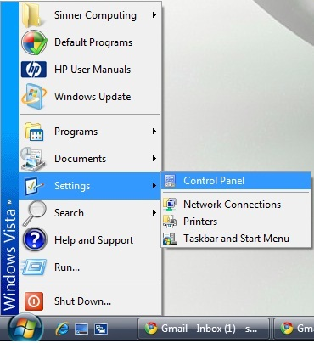
Create a ODBC connection for the Database (Creating DSN)
Click Start, and then click Control Panel.

Slide 39
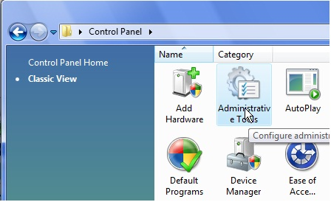
2. In the Control Panel, double-click Administrative Tools.

Slide 40
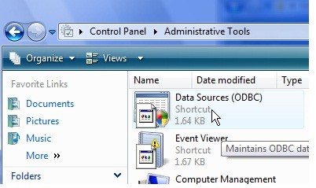
3.In the Administrative Tools dialog box, double-click Data Sources (ODBC).

Slide 41
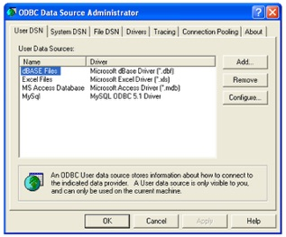
4.The ODBC Data Source Administrator dialog box appears.

Slide 42
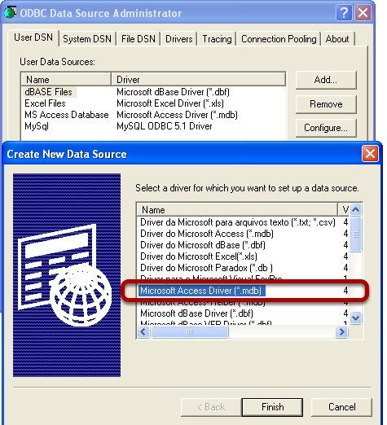
5. Click User DSN, System DSN, or File DSN, depending on the type of data source you want to add.
6. Click Add.

Slide 43
7.Select the driver that you want to use, and then click Finish or Next.

Slide 44
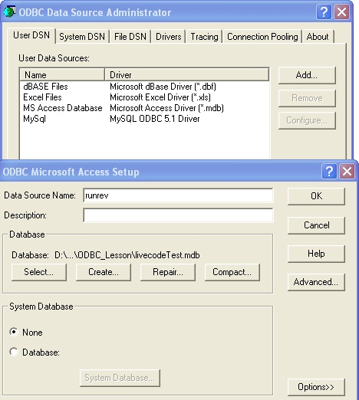
8. Selecting the Database file and Naming it and/or assigning name and password

Slide 45
The Connection interface:
used to connect java application with particular database
Once connection with database is created, we can execute SQL statements for that particular connection using object of Connection and retrieve the results.
Methods
Method | Description
void close() | This method closes the Connection from database.
void commit() | This method makes all the changes made since the last commit or rollback permanent. It throws SQLExeception.

Slide 46
Method | Description
void rollback() | This method undoes all changes made to the database.
boolean isClosed() | Return true if the connection is close else return false.
void setAutoCommit(boolean status) | It is used to set the commit status.By default it is true.
Statement createStatement() | creates a statement object that can be used to execute SQL queries. It throws SQLExeception.
Statement createStatement(int RSType, int RSConcurrency) | creates a statement object will generate ResultSet objects with the given type and concurrency.

Slide 47
Method | Description
CallableStatement prepareCall(String s) | It creates CallableStatement object for calling the stored procedures from database. It throws SQLExeception.
CallableStatement prepareCall(String s, int RSType, int RSConcurrency) | creates a CallableStatement object will generate ResultSet objects with the given type and concurrency.
PreparedStatement prepareStatement(String s) | It creates an PrepareStatement object for sending dynamic SQL statements to the database. It throws SQLExeception.
PreparedStatement prepareStatement(String s, int RSType, int RSConcurrency) | creates a PreparedStatement object will generate ResultSet objects with the given type and concurrency.

Slide 48
Statement Interface:
Used to execute a static query
It’s a very simple and easy so it also called as “Simple Statement”.

Slide 49
Method | Description
void close() | It closes Statement object.
boolean execute(String s) | It executes the SQL statement specified by s.
ResultSet getResulSet() | It retrieves the ResultSet that is generated by the execute() method.
ResultSet executeQuery(String s) | It is used to execute the SQL statement specified by s and returns the object of type ResultSet.
int getMaxRows() | Returns the maximum number of rows those are generated by the executeQuery() method
int executeUpdate(String s) | It executes the SQL statement specified by s. The SQL statement may be a SQL create, insert, update and delete statement.

Slide 50
PreparedStatement Interface
used to execute a dynamic query
Also used to execute a parameterized or precompiled SQL statement/query
to pass different values to an query “?” is used in the query and the actual values can be passed using the setXXX() method at the time of execution.
Query with IN parameter uses “?”.
Syntax :
setXXX(int location ,XXX value);
Where XXX means a data type

Slide 51
For example:
String query = "Select * from Data where
ID = ? and Name = ? ";
PreparedStatement ps = con.prepareStatement(query);
ps.setInt(1, 1);
ps.setString(2, “xyz");

Slide 52
Method | Description
void close() | It closes PreparedStatement object.
boolean execute() | It executes the dynamic query in the object of type Prepared Statement.
ResultSet getResult | It retrieves the ResultSet that is generated by the execute() method.
ResultSet executeQuery() | It is used to execute dynamic query in the object of type Prepared Statement and returns the object of type ResultSet.
int getMaxRows() | Returns the maximum number of rows those are generated by the executeQuery() method
int executeUpdate() | It executes the execute dynamic query in the object of type Prepared Statement. The SQL statement may be a SQL create, insert, update and delete statement.

Slide 53
CallableStatement Interface
used to call the stored procedures and functions
use of stored procedures and functions gives better performance because these are precompiled.
Example:
CallableStatement stmt=con.prepareCall("{call myprocedure(?,?)}");

Slide 54
ResultSet interface
Maintains a cursor pointing to a row of a table.
Initially, cursor points to before the first row.
By default, ResultSet object can be moved forward only and it is not updatable.

Slide 55
Type of ResultSet
ResultSet.TYPE_FORWARD_ONLY | The cursor can only move forward in the result set.
ResultSet.TYPE_SCROLL_INSENSITIVE | It indicates that ResultSet object that is scrollable but generally not sensitive to changes to the ResultSet data.
ResultSet.TYPE_SCROLL_SENSITIVE | It indicates that ResultSet object that is scrollable and sensitive to changes to the ResultSet data.

Slide 56
Concurrency of ResultSet
ResultSet.CONCUR_READ_ONLY | Creates a read-only result set. This is the default
ResultSet.CONCUR_UPDATABLE | Creates an updatable result set.

Slide 57
Navigating a Result Set
Method | Description
public void beforeFirst() throws SQLException | Moves the cursor just before the first row.
public void afterLast() throws SQLException | Moves the cursor just after the last row.
public boolean first() throws SQLException | Moves the cursor to the first row.
public void last() throws SQLException | Moves the cursor to the last row.
public boolean absolute(int row) throws SQLException | Moves the cursor to the specified row
public boolean relative(int row) throws SQLException | Moves the cursor the given number of rows forward or backward, from where it is currently pointing

Slide 58
Method | Description
public boolean previous() throws SQLException | Moves the cursor to the previous row
public boolean next() throws SQLException | Moves the cursor to the next row. This method returns false if there are no more rows in the result set.
public int getRow() throws SQLException | Returns the row number that the cursor is pointing to.

Slide 59
Viewing a ResultSet
There is a get method for each of the possible data types, and each get method has two versions −
One that takes in a column name.
One that takes in a column index.
XXX means a data type
int getXXX(String columnName) throws SQLException
int getXXX(int columnIndex) throws SQLException

Slide 60
THANK YOU

